Slide 1

TOPIC- The Handwritten Digit Recognition System
Presented by- Presented to-
Ayush Yadav (202210101150081) Mrs. Nitika Gupta

Slide 2
Table of contents
01
02
03
04
05
06
Introduction
Dataset Spotlight: MNIST The Gold Standard
TOOLS AND TECHNOLOGIES USED
PROJECT OBJECTIVES
MODEL ARCHITECTURE
07
08
09
CHALLENGES
CONCLUSION
PREPROCESSING PLAN
EXPECTED OUTCOMES

Slide 3
01
Introduction

Slide 4
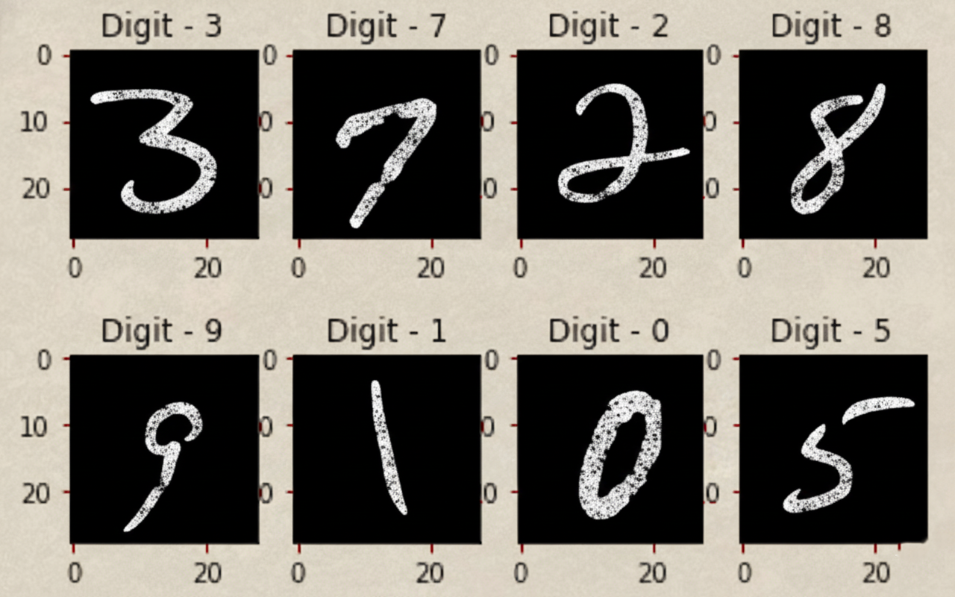
INTRODUCTION
Handwritten digit recognition is the task of automatically identifying digits written by humans.
It is widely used in real-world applications such as:
Postal code recognition
Cheque processing
Digitizing handwritten forms and documents
Deep learning, especially convolutional neural networks, allows the system to learn patterns and features directly from the images, without manual feature extraction.

Slide 5
02
PROJECT OBJECTIVES

Slide 6
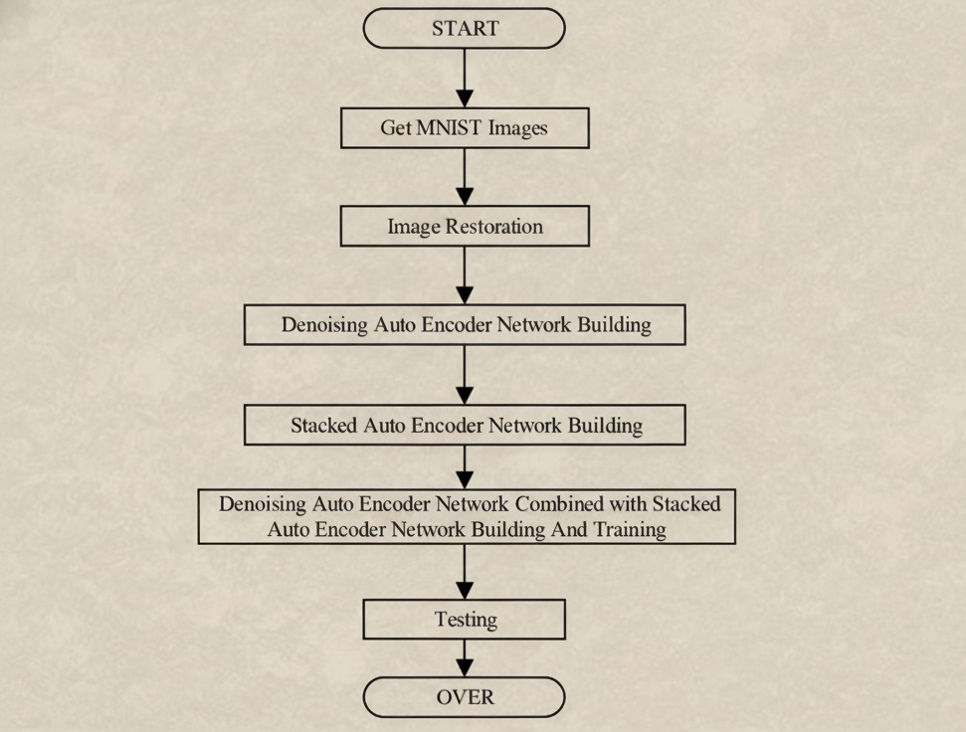
PROJECT OBJECTIVES
Develop a deep learning model capable of classifying handwritten digits.
Train the model using the MNIST dataset.
Achieve high accuracy and robust performance.
Build a simple web or desktop demo for real-time prediction.

Slide 7
03
Dataset Spotlight: MNIST The Gold Standard

Slide 8
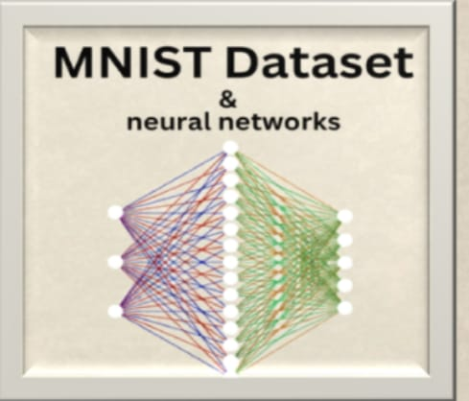
Dataset Spotlight: MNIST The Gold Standard
The Modified National Institute of Standards and Technology (MNIST) dataset is the foundational benchmark for image classification
42000 rows training data
785 columns as features
5600 rows testing data
784 columns as features
Each image: 28x28 pixels, grayscale

Slide 9
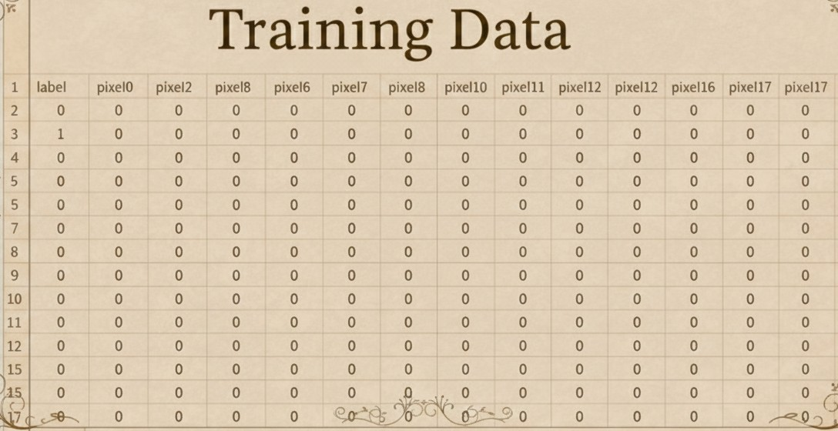
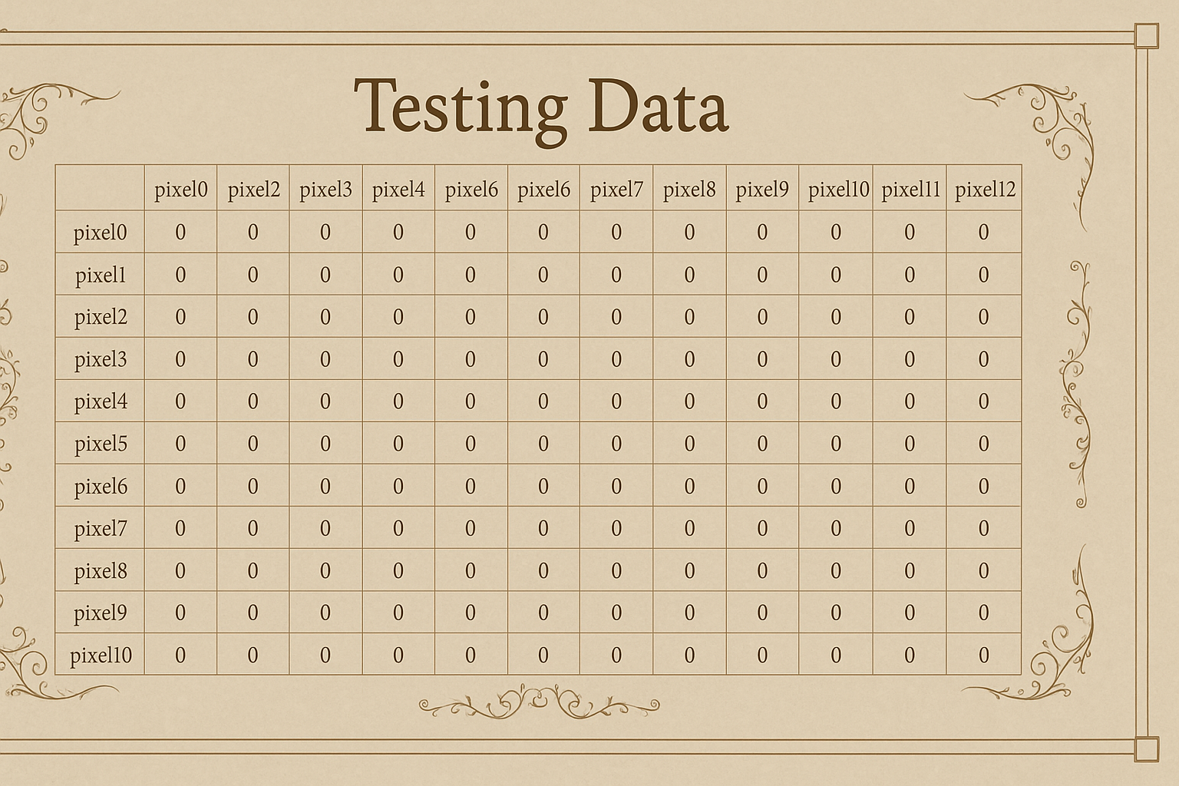

Slide 10
04
TOOLS AND TECHNOLOGIES USED

Slide 11

TOOLS AND TECHNOLOGIES USED
Programming Language: Python
Libraries Used:
TensorFlow → Model Training
OpenCV → Image Preprocessing
HTML , CSS, Javascript and React → Frontend Demo
NumPy, Pandas, Matplotlib, Scikit-learn → Analysis & Visualization, TensorFlow

Slide 12
05
MODEL ARCHITECTURE

Slide 13
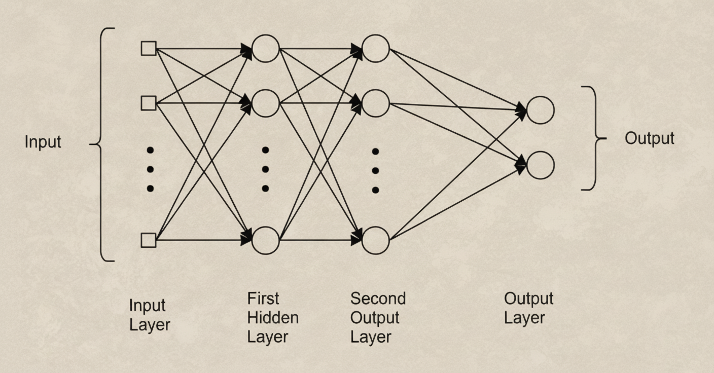
MODEL ARCHITECTURE
Input Layer: Flattened 28×28 pixel image (784 neurons)
Hidden Layers: Fully connected layers with ReLU activation
Output Layer: 10 neurons (softmax) for digits 0–9
Optimizer: Adam
Loss Function: Sparse Categorical Crossentropy
Metrics: Accuracy
Epochs: 10 iterations

Slide 14
06
PREPROCESSING PLAN

Slide 15
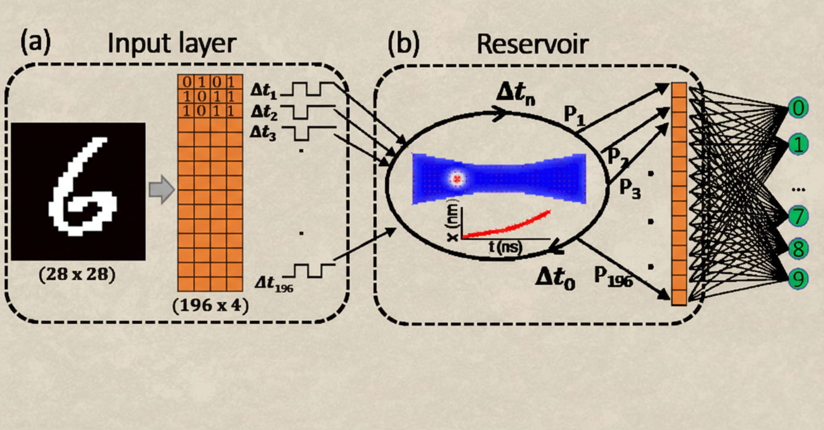
PREPROCESSING PLAN
Ensure input is in correct DataFrame format.
Apply thresholding
Convert pixel values to numbers and fill missing ones with 0.
Normalise the pixels to a 0–1 range (divide by 255) so the model can learn more efficiently.
Resize to 28×28 pixels

Slide 16
07
EXPECTED OUTCOMES

Slide 17
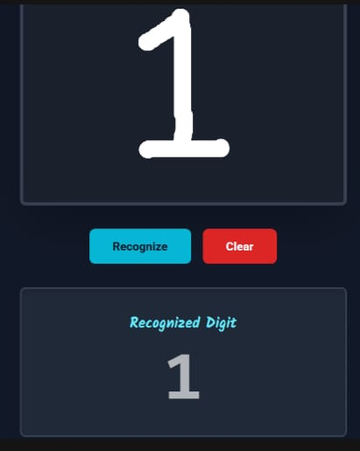
EXPECTED OUTCOMES
High Accuracy Digit Classification:
Real-Time Prediction Capability:
Visual Demonstration of Model Performance:
Confusion matrix and sample predictions will show which digits are recognized well and where improvements are possible.
The model is expected to achieve ~98–99% accuracy on standard MNIST dataset.
It will correctly identify most handwritten digits despite variations in style or thickness.
Users can upload handwritten digits (via webcam or image) and get instant predictions.
Demonstrates practical usability and interaction for non-technical users.

Slide 18
08
CHALLENGES

Slide 19
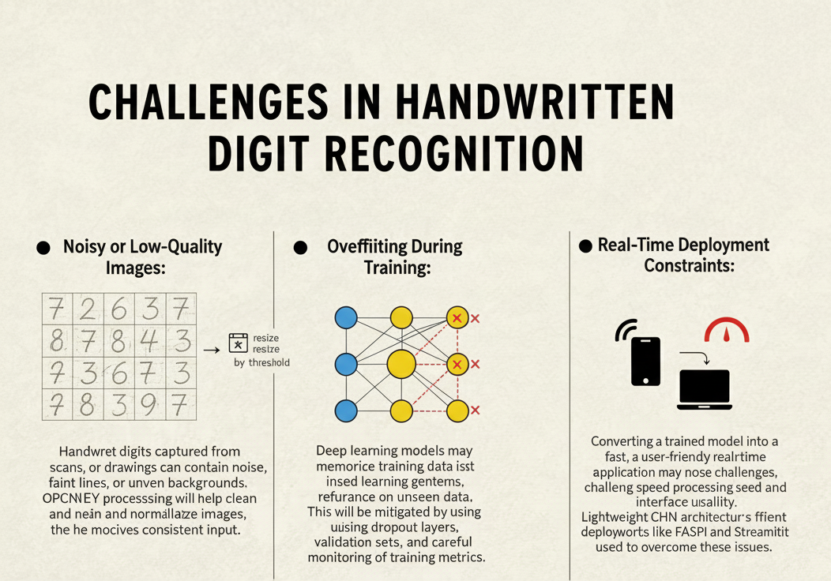
CHALLENGES
Noisy or Low-Quality Images: Handwritten digits captured from scans, photos, or drawings can contain noise, faint lines, or uneven backgrounds. OpenCV preprocessing will help clean and normalize images, ensuring the model receives consistent input.
Overfitting During Training: Deep learning models may memorize training data instead of learning general patterns, reducing performance on unseen data. This will be mitigated by using dropout layers, validation sets, and careful monitoring of training metrics.
Real-Time Deployment Constraints: Converting a trained model into a fast, user-friendly real-time application may pose challenges, such as processing speed and interface usability.

Slide 20
09
CONCLUSION

Slide 21
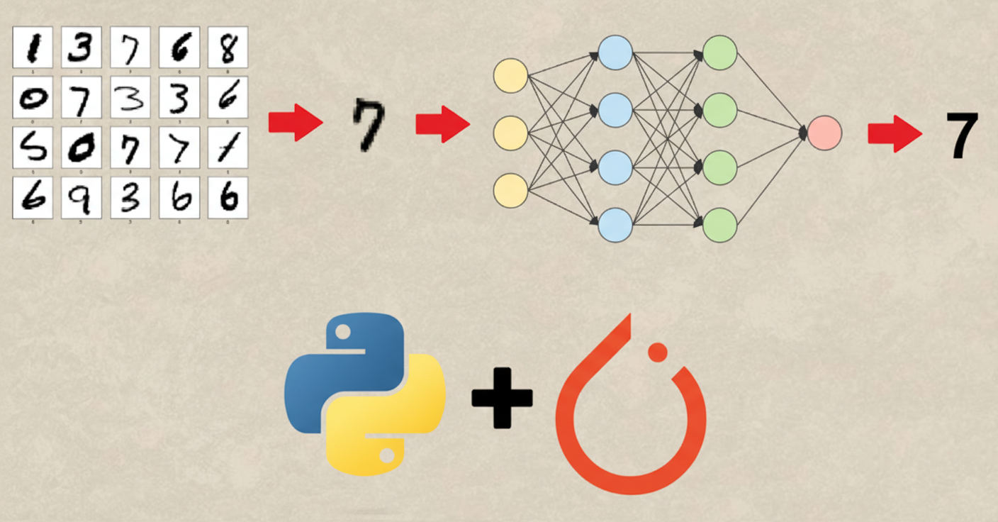
CONCLUSION
This project proposes a CNN-based system for handwritten digit recognition.
Preprocessing techniques using OpenCV and a well-structured model architecture are planned to ensure accurate and robust predictions.
A real-time demonstration will allow users to interactively test the system and observe its capabilities.
Overall, this project aims to provide a practical, scalable, and extendable solution for automated digit recognition, laying a foundation for future enhancements in handwriting recognition technology.

Slide 22
Thanks!

